Slide 1
COMP 306: API Engineering & Cloud Computing
Class Activity 03 – AWS Elastic Beanstalk WORKSHOP
Created By: Kevin Ma (#300867968)
Fall 2018

Slide 2
Class Activity 03 – AWS Elastic Beanstalk WORKSHOP
AWS Elastic Beanstalk Basics

Slide 3
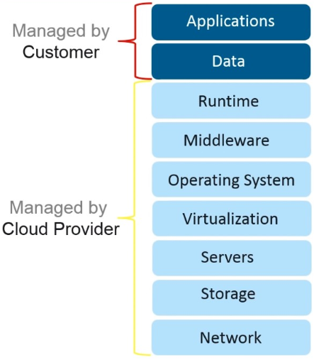
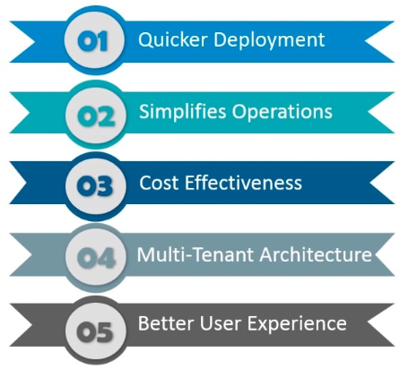
PAAS (Platform-as-a-service)

Slide 4
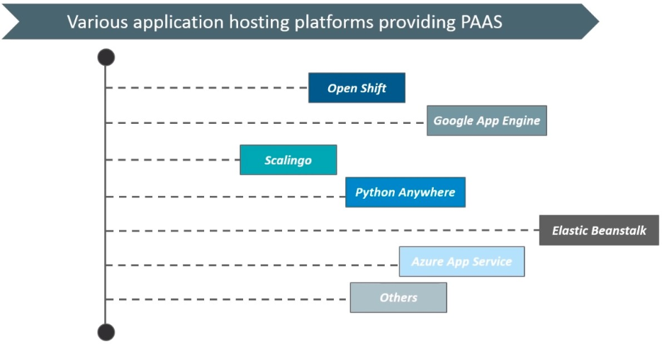
Web Hosting Platforms

Slide 5
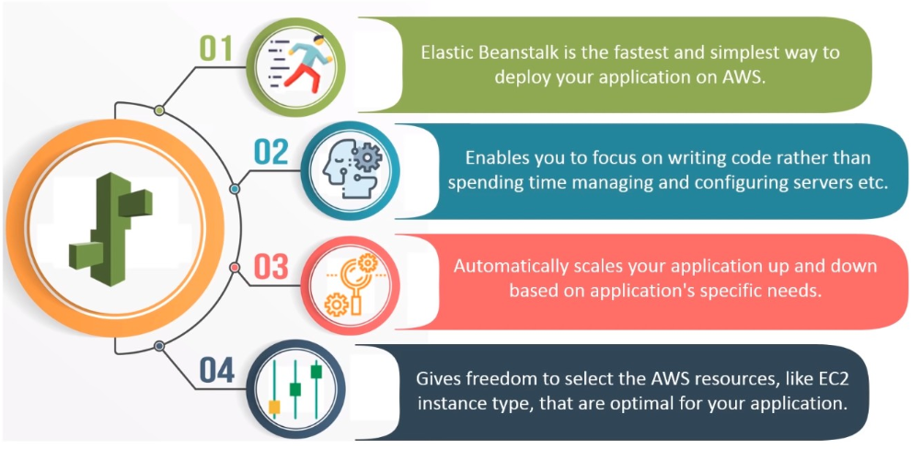
Features of AWS Elastic Beanstalk

Slide 6
What is AWS Elastic Beanstalk
AWS Elastic Beanstalk(EB) is a PaaS for deploying, scaling, and managing web applications and services
EB supports web applications developed in Java, PHP, .NET, Node.js, Python, Ruby and Go
Supports many web servers such as:
Apache
Nginx (recommend to be used on Linux)
Passenger (runs and manages Ruby, Node.js, and Python apps)
IIS

Slide 7
EB Components
Application
Logic collection of EB components, including environment, versions, and environment configurations
Application version (specific source code version for web app)
Environment
Web server environment (web server tier)
Worker environment (worker tier)
Environment configuration
Configuration template
Starting point for creating unique env confs which can be created or modified using CLI or API

Slide 8
Environment Tiers
Web servers
Standard applications that listen for and then process HTTP request, typically over port 80
Worker environments
Specialized apps that have background process task listening for message on an Amazon SQS (Simple Queue Service) queues
These messages get posted to your app by worker apps using HTTP

Slide 9
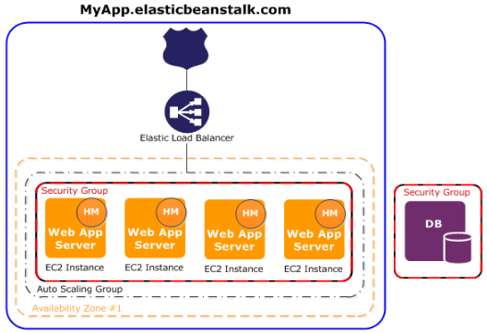
AWS EB Environments – Web Server Tier
Environment is surrounded by blue line
Upon env creation, EB provisions the resources (i.e. elastic load balancer, auto scaling group, one or more EC2 instances) required to run the app
Security group acts as virtual firewall that controls traffic for one or more instances

Slide 10
AWS EB Environments – Worker Tier
Operations or workflows that take a long time to complete should be offloaded from the web server to dedicated worker environment
Long-running task is anything that substantially increases the time it takes to complete a request (e.g. processing video/images, sending email, or generating a ZIP archive)
NOTE: these ops can take only 1-2 seconds to complete, but these delays are a lot for web requests which normally complete in <= 500ms.

Slide 11
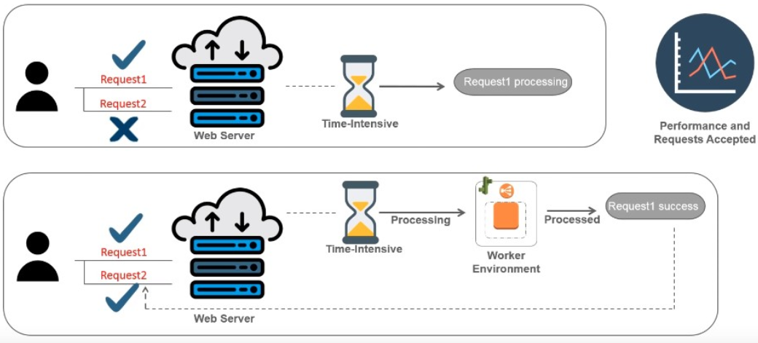
Why Do We Need Worker Environments?

Slide 12
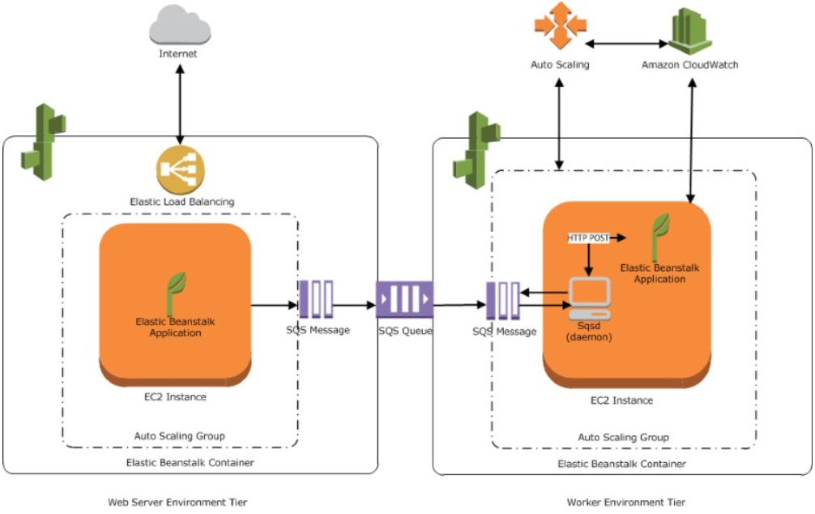
How Do Worker Environments Work

Slide 13
AWS Simple Queue Service (SQS)
Fully managed message queuing service that makes it easy to decouple and scale microservices, distributed systems and serverless applications
Amazon SQS moves data between distributed application components and helps you decouple these components

Slide 14
Amazon Route 53
Highly available and scalable cloud Domain Name System (DNS) web service
DNS translates human readable domain names to machine readable IP addresses
E.g. www.amazon.com -> 192.0.2.44
Designed to provide extremely reliable and cost effective way to route end users to Internet applications
Effectively connects user requests to infrastructure running in/outside of AWS
E.g. Amazon EC2 instances, Elastic Load Balancing load balancers, Amazon S3 buckets, etc.

Slide 15
Amazon CloudFront
Web service that speeds up distribution of static and dynamic web content, such as .html, and image files to end users
Delivers content through a worldwide network of dta centers called edge locations
AWS Edge Location is the place where the data’s are cached to reduce the latency to the end users
Located in major cities around the world
These infrastructure are used to provide services such as cloudfront, lambda, etc.

Slide 16
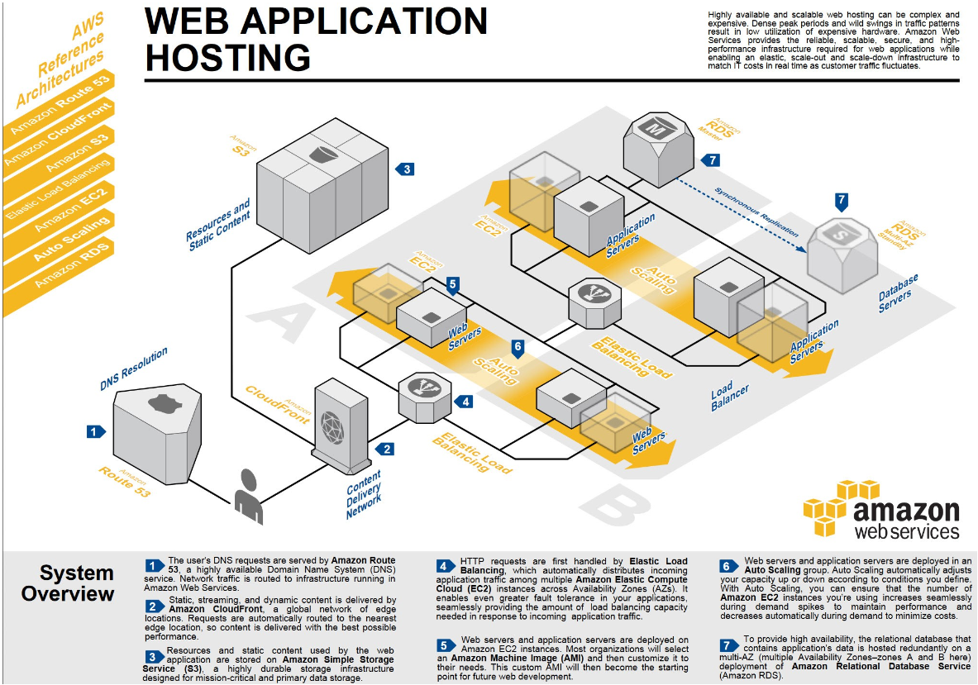
Putting it all Together

Slide 17
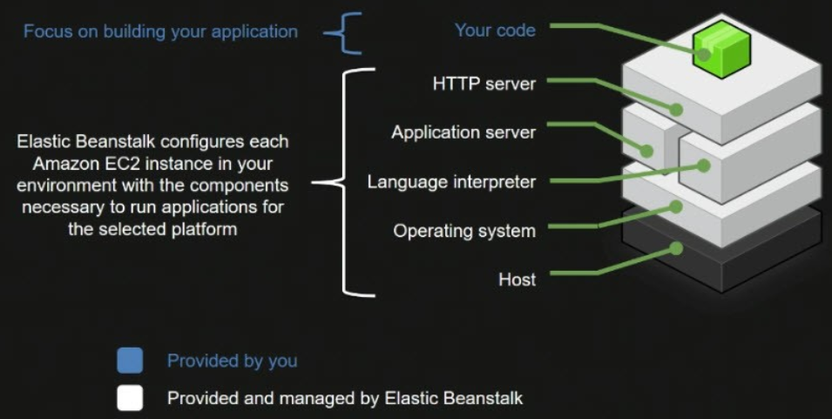
Breaking it Down: On-Instance Config

Slide 18
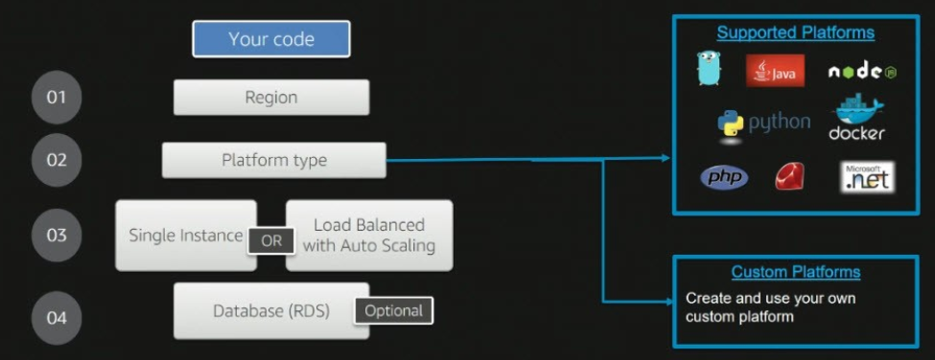
Information Required to Deploy Apps

Slide 19
Class Activity 03 – AWS Elastic Beanstalk WORKSHOP
Hands-on Activities

Slide 20
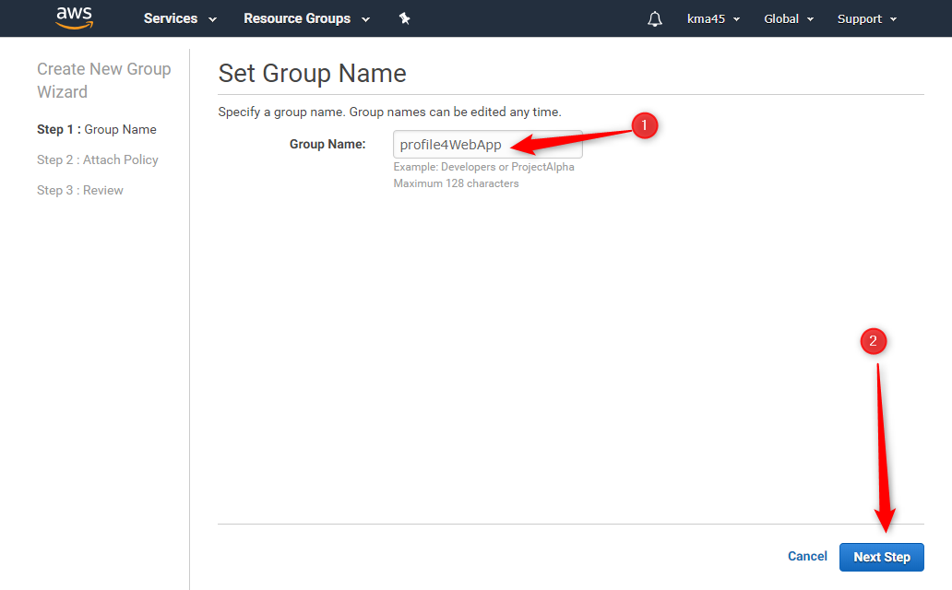
Create a Group in IAM

Slide 21
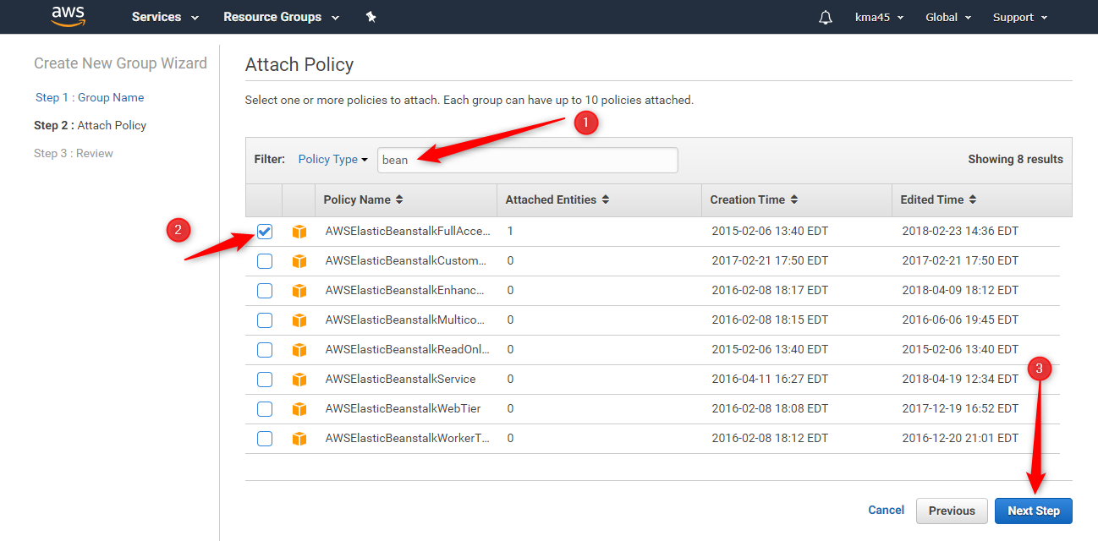
IAM Group Configuration

Slide 22
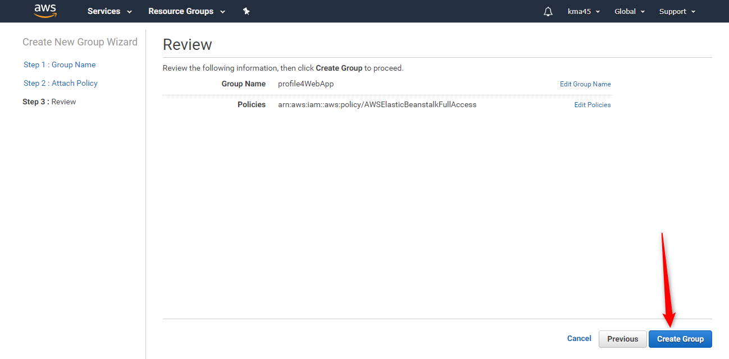
Create a Group in IAM

Slide 23
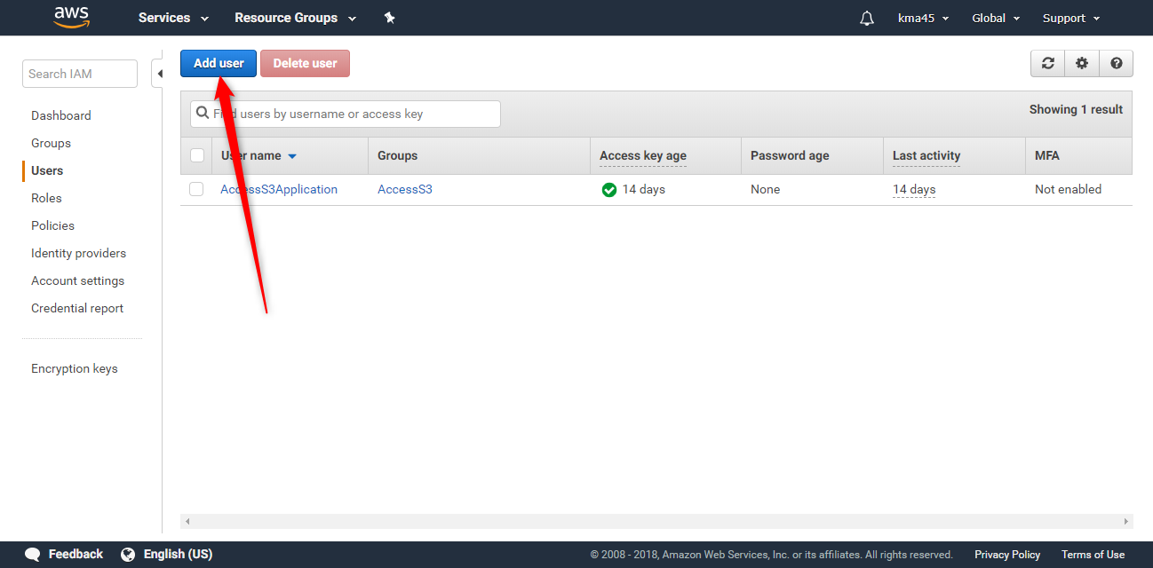
Create a User in IAM

Slide 24
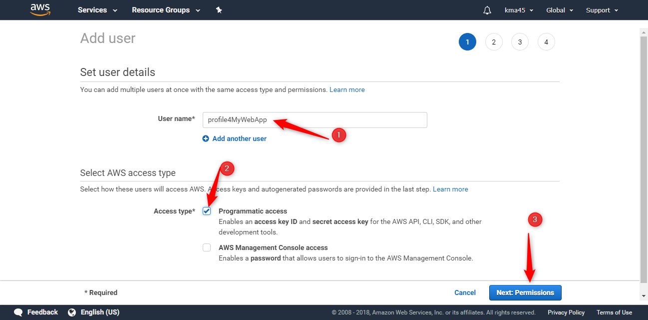
Create a User in IAM

Slide 25
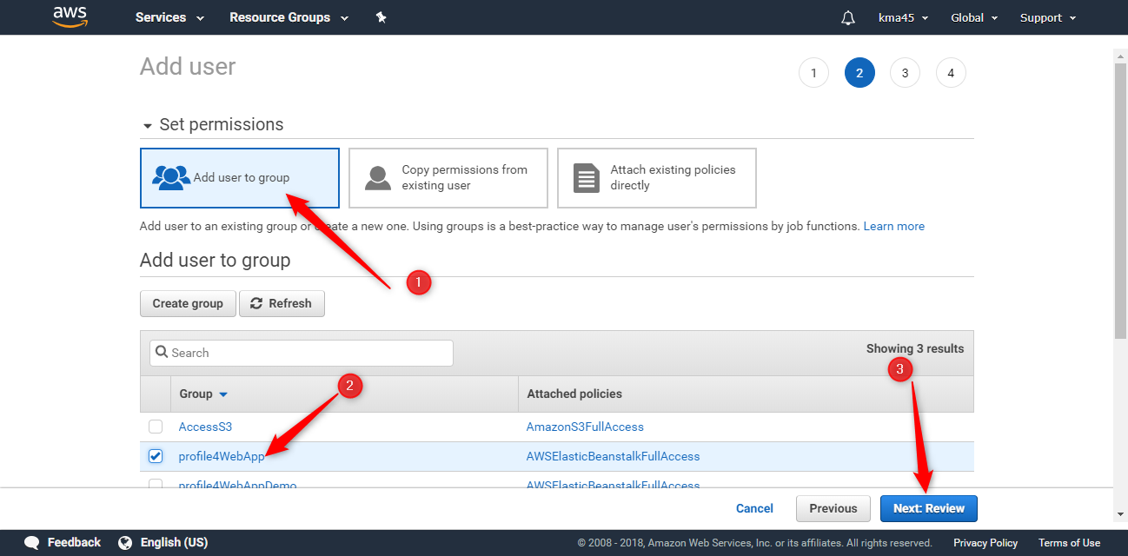
Create a User in IAM

Slide 26
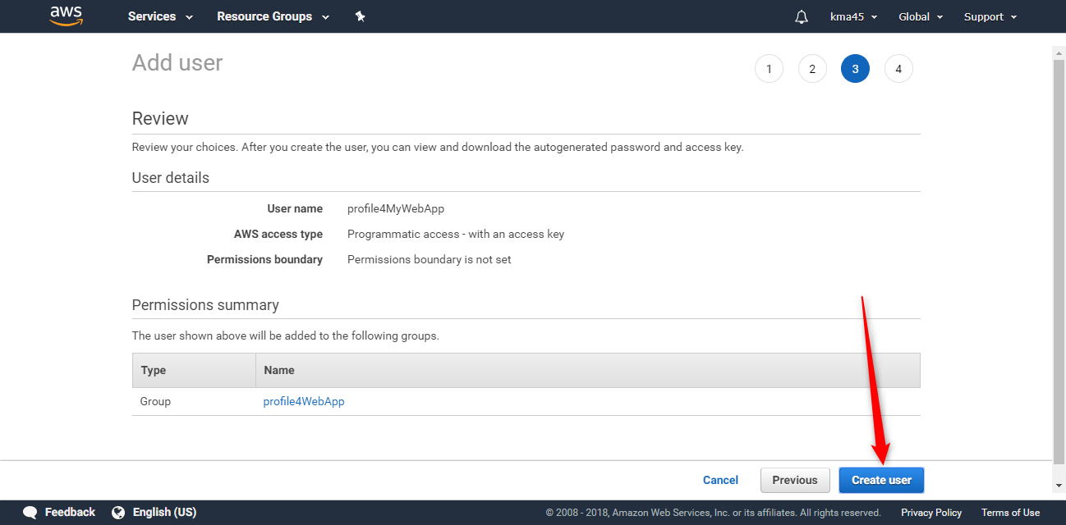
Create a User in IAM

Slide 27
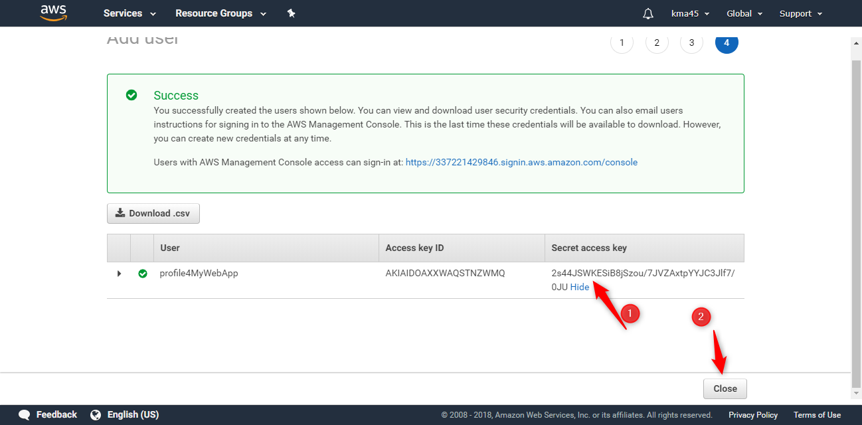
Create a User in IAM

Slide 28
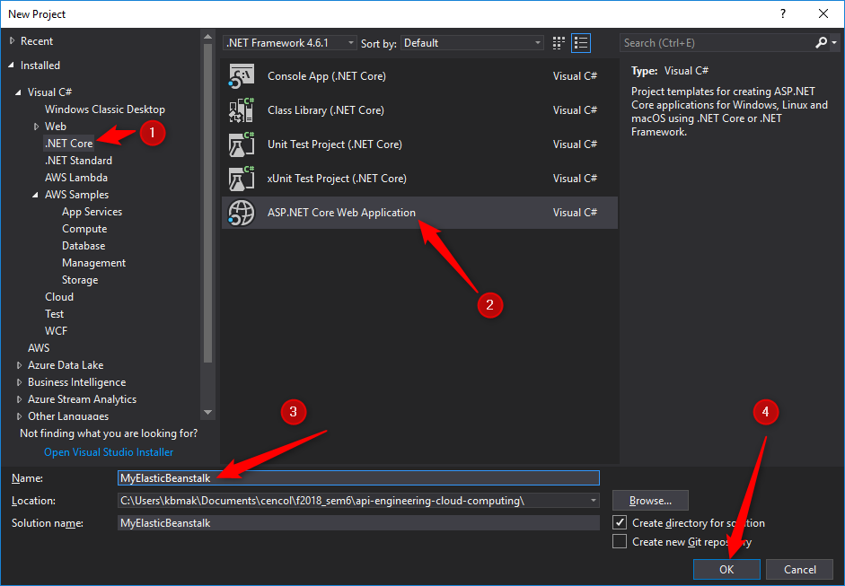
Develop an ASP.NET Core Web Application

Slide 29
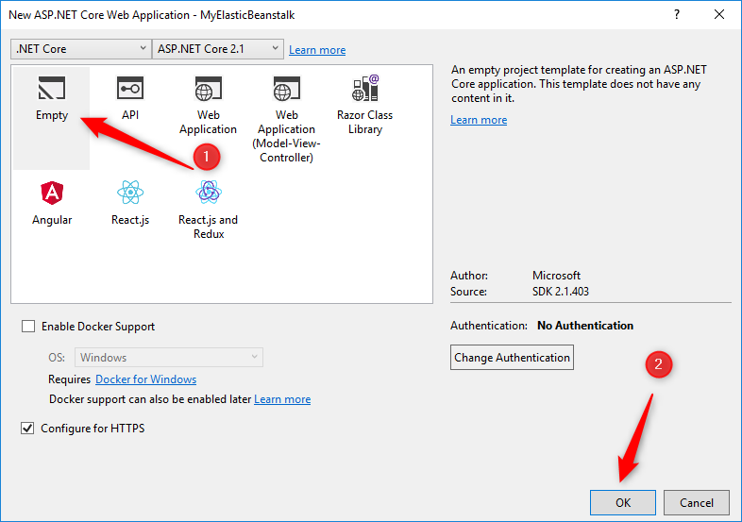
Develop an ASP.NET Core Web Application

Slide 30
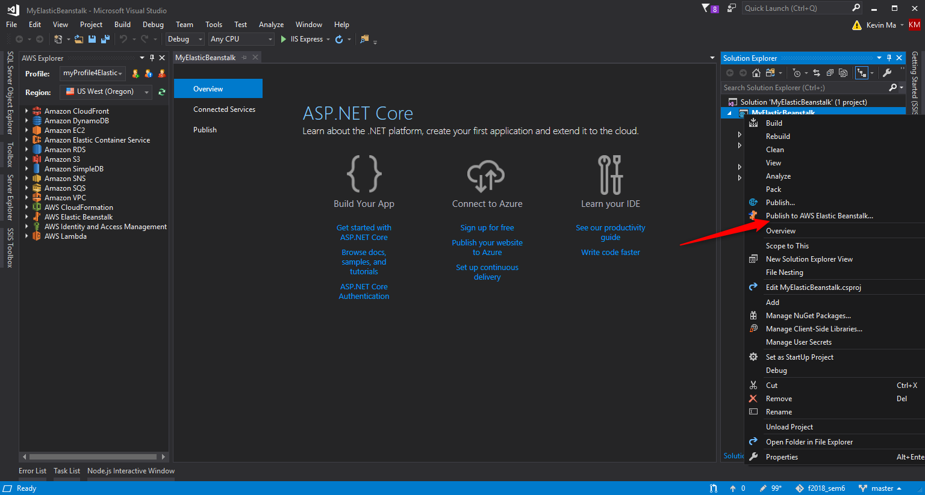
Develop an ASP.NET Core Web Application

Slide 31
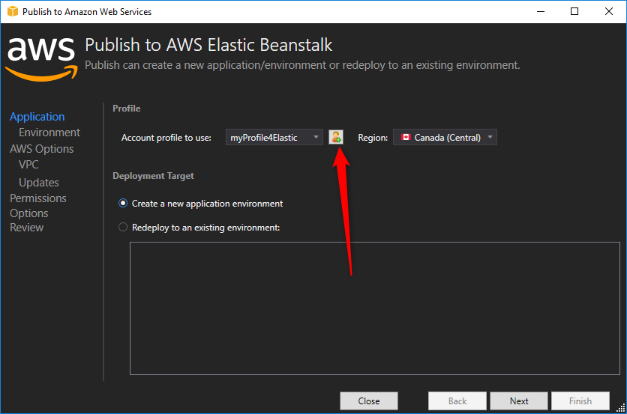
Develop an ASP.NET Core Web Application

Slide 32
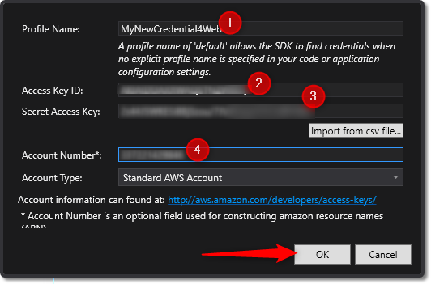
Develop an ASP.NET Core Web Application

Slide 33
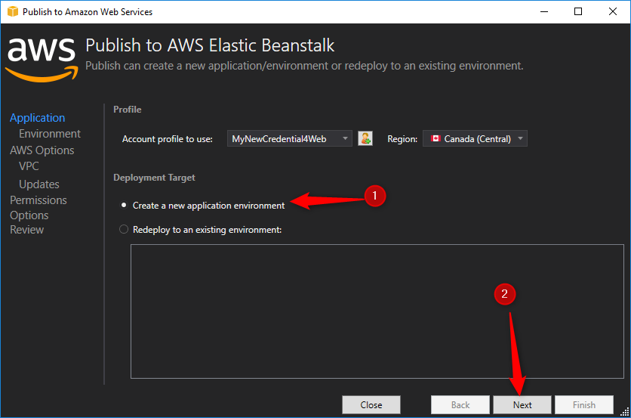
Develop an ASP.NET Core Web Application

Slide 34
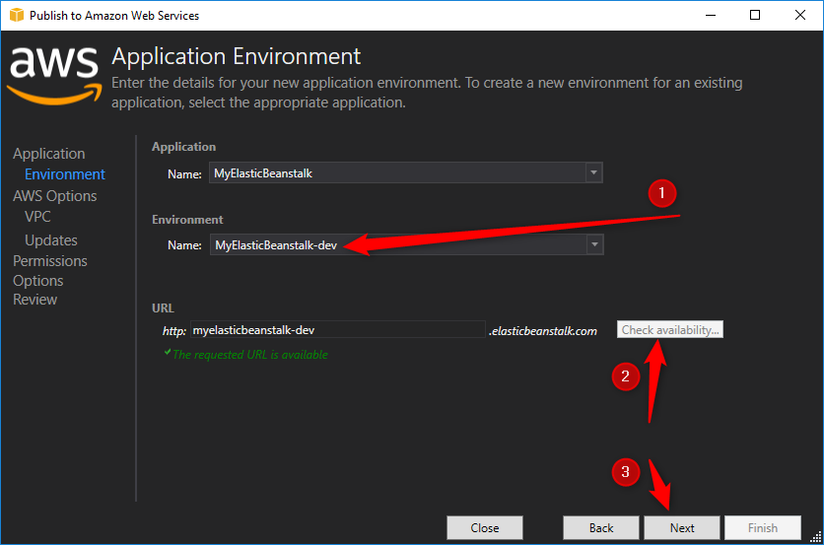
Develop an ASP.NET Core Web Application

Slide 35
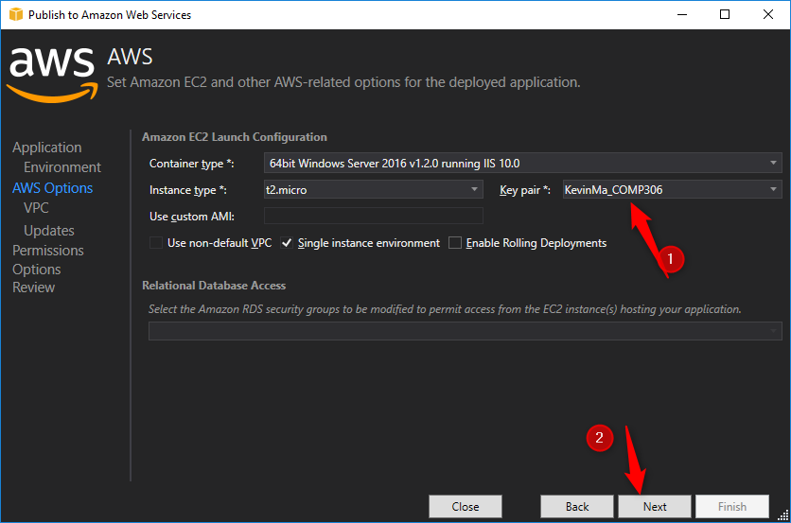
Develop an ASP.NET Core Web Application

Slide 36
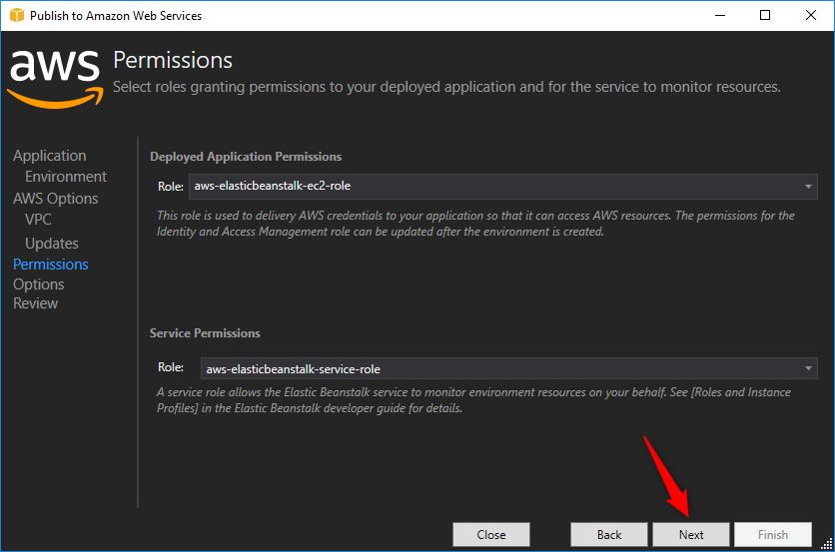
Develop an ASP.NET Core Web Application

Slide 37
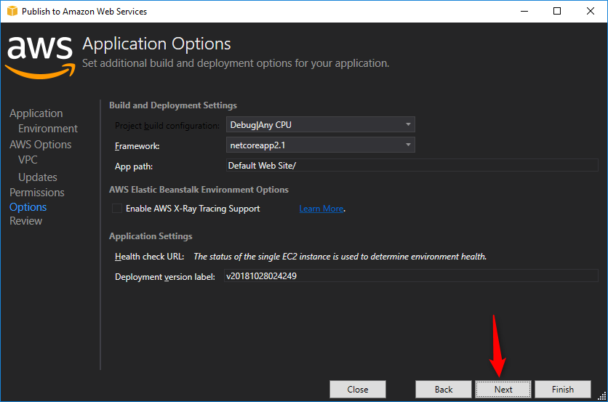
Develop an ASP.NET Core Web Application

Slide 38
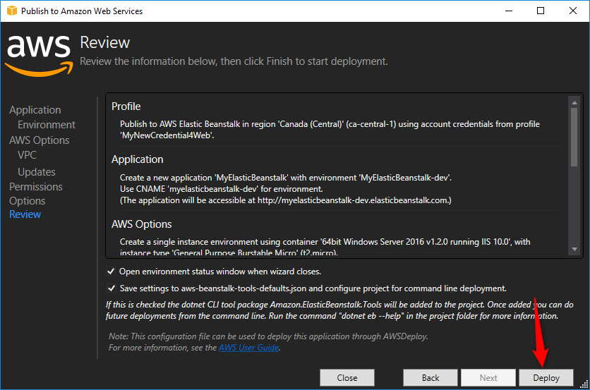
Develop an ASP.NET Core Web Application

Slide 39
Develop an ASP.NET Core Web Application

